Slide 1
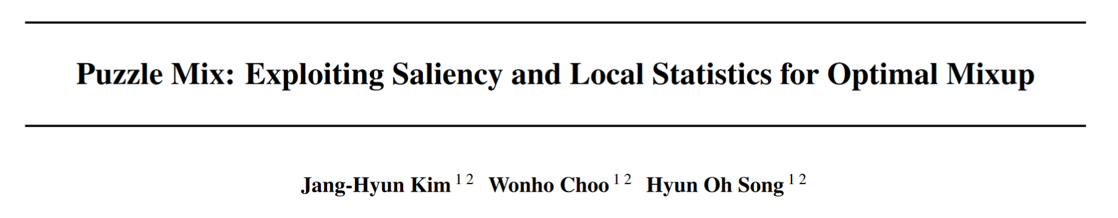
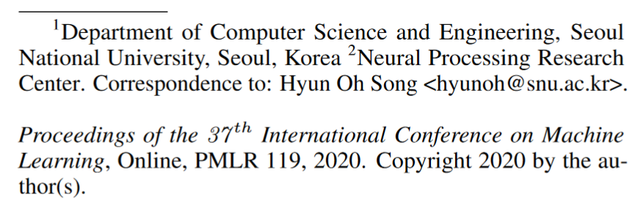
ICML 2020
2023.11.01

Slide 2
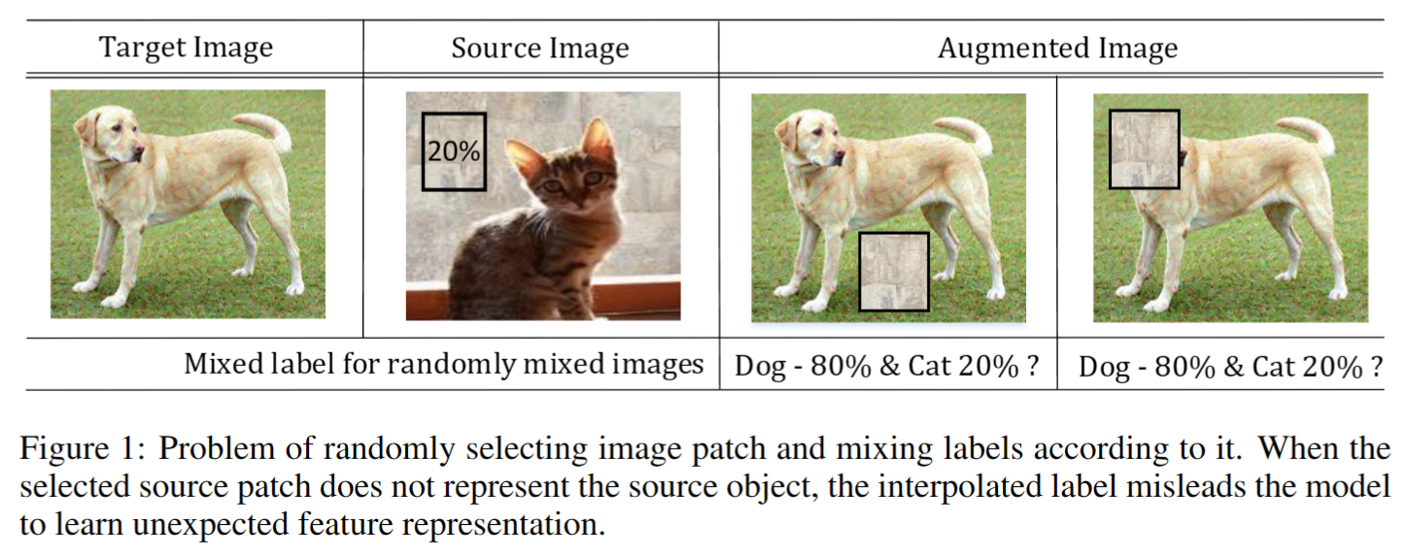
Puzzle Mix: Exploiting Saliency and Local Statistics for Optimal Mixup [ICML2020]
Data augmentation
data-warping augmentation
mixup-based method

Slide 3
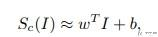
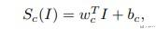
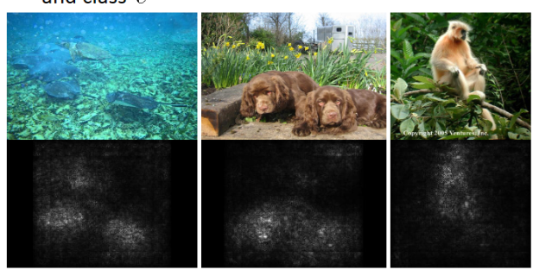
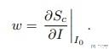
Puzzle Mix: Exploiting Saliency and Local Statistics for Optimal Mixup [ICML2020]
Saliency Maps
整体的目标 :
给一张图片 I_0, 对应的分类是c, 有一个模型给出图片I_0 的概率值是S_c(I), 我们想要衡量I_0 的某个像素点对分类器S_c(I) 的影响.
简单的解释 :
假如我们的模型S_c(I)是一个线性模型，如下所示
那么我们就可以通过观察W 的大小来看出每个像素点对应的重要度的信息。
对于复杂的网络来说，模型S_c(I)是一个复杂的非线性模型。但是对于给的图像I_0, 我们可以在I_0 的周围对模型S_c(I) 进行一阶泰勒展开，如下所示：
其中的W就是模型S_c(I) 对I 的导数：
所以，最终我们要做的就是计算W的值。到这里W的计算方式也给出来了，其实就是整个网络进行方向传播，计算输入X 的梯度，就是这里的W.
data-warping augmentation
mixup-basd method

Slide 4
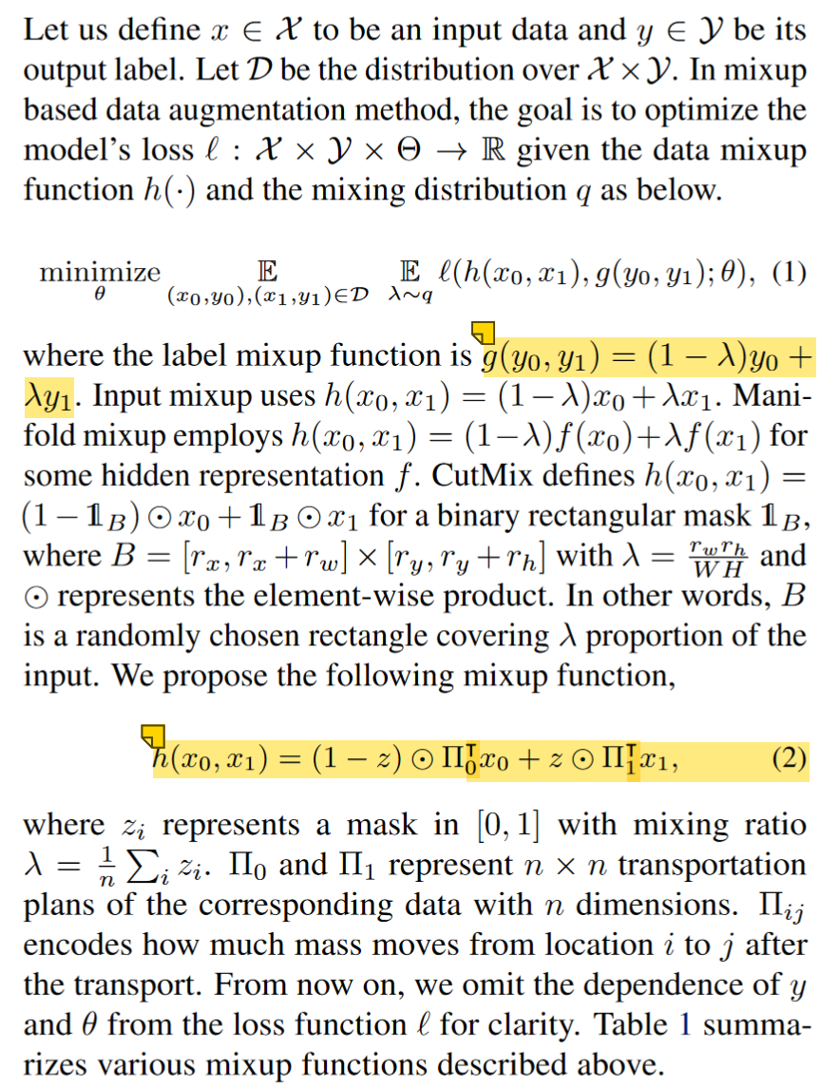
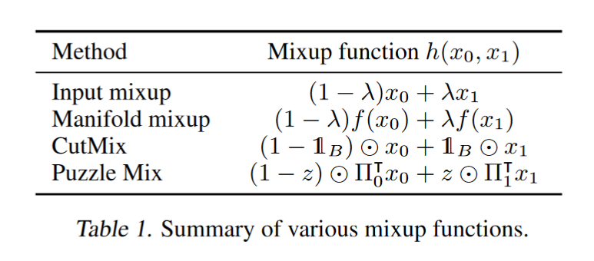
Puzzle Mix: Exploiting Saliency and Local Statistics for Optimal Mixup [ICML2020]

Slide 5
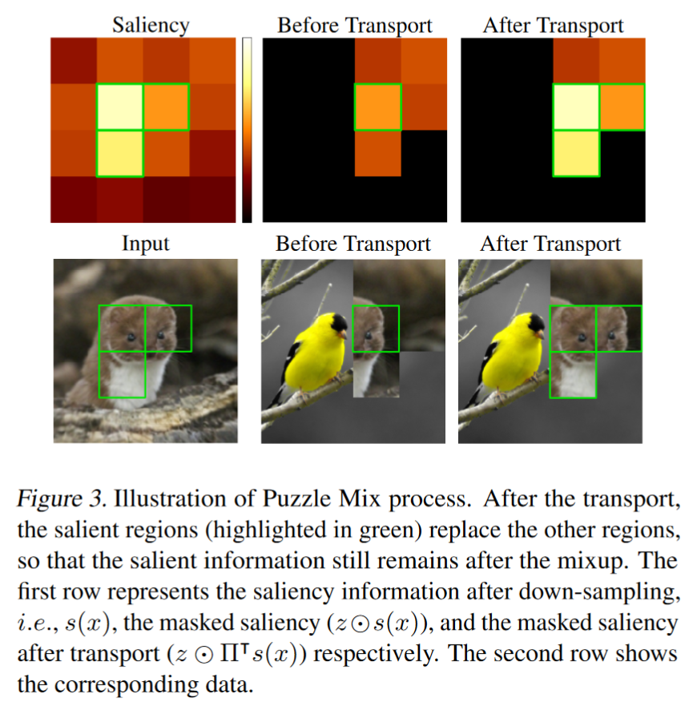
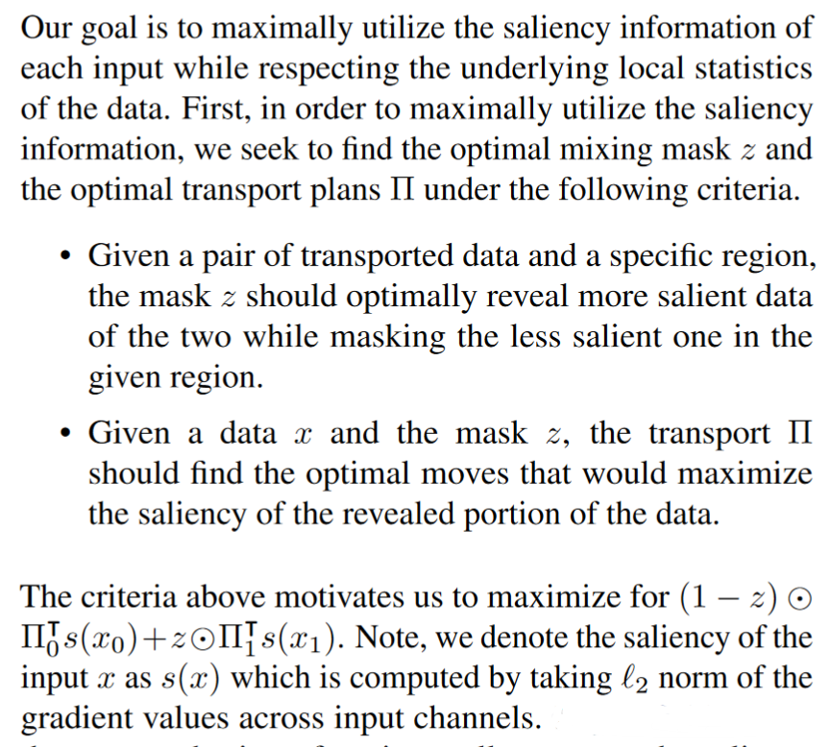
Puzzle Mix: Exploiting Saliency and Local Statistics for Optimal Mixup [ICML2020]

Slide 6
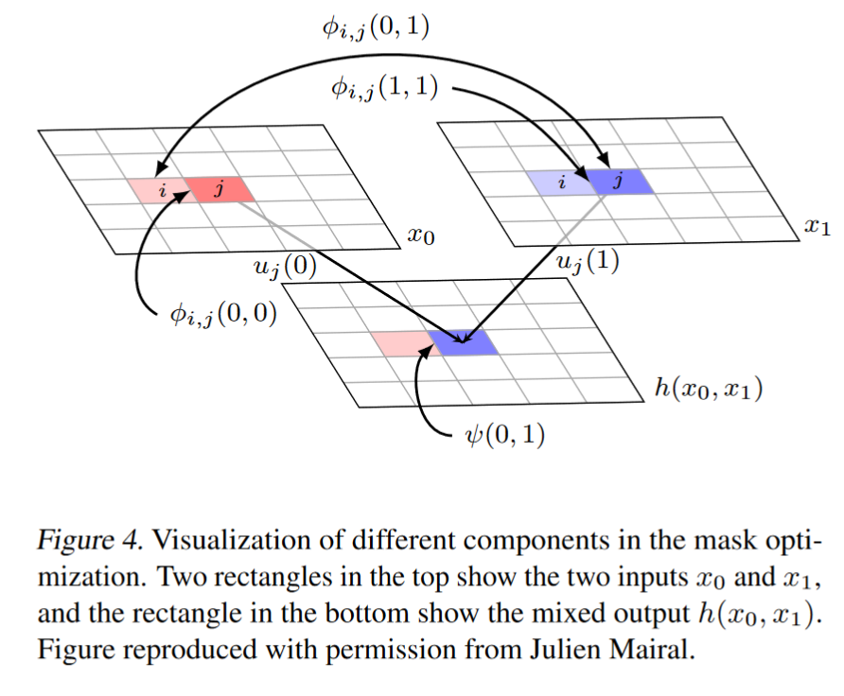
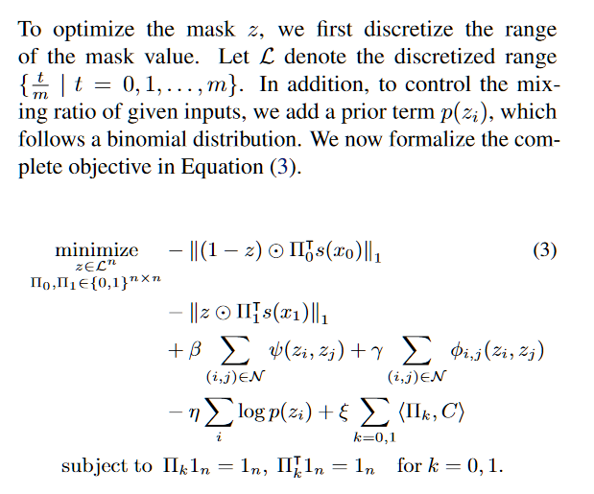
Puzzle Mix: Exploiting Saliency and Local Statistics for Optimal Mixup [ICML2020]

Slide 7
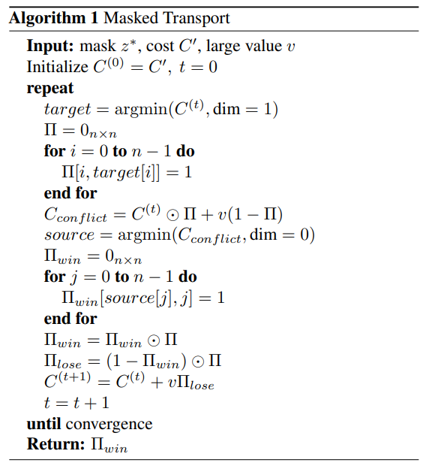
Puzzle Mix: Exploiting Saliency and Local Statistics for Optimal Mixup [ICML2020]

Slide 8
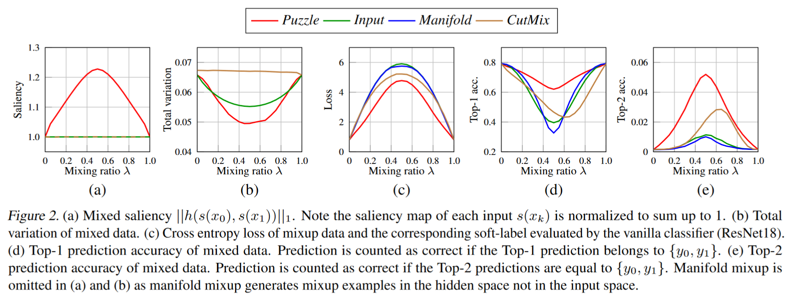
Puzzle Mix: Exploiting Saliency and Local Statistics for Optimal Mixup [ICML2020]

Slide 9
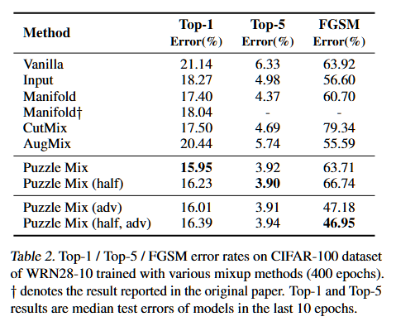
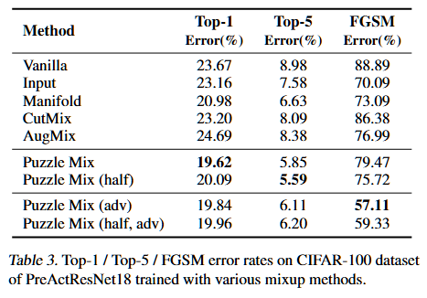
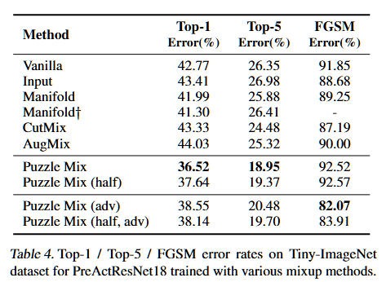
Puzzle Mix: Exploiting Saliency and Local Statistics for Optimal Mixup [ICML2020]

Slide 10
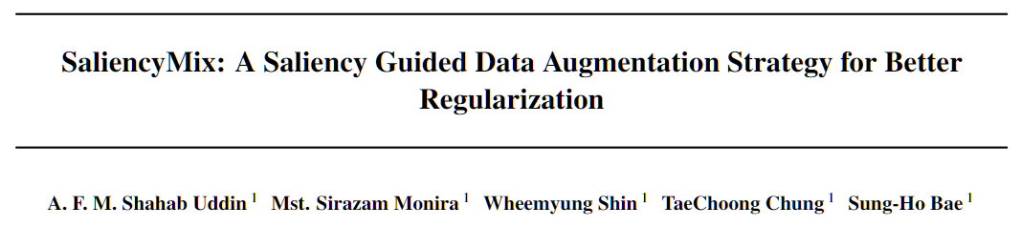
ICLR 2021
2023.11.01

Slide 11
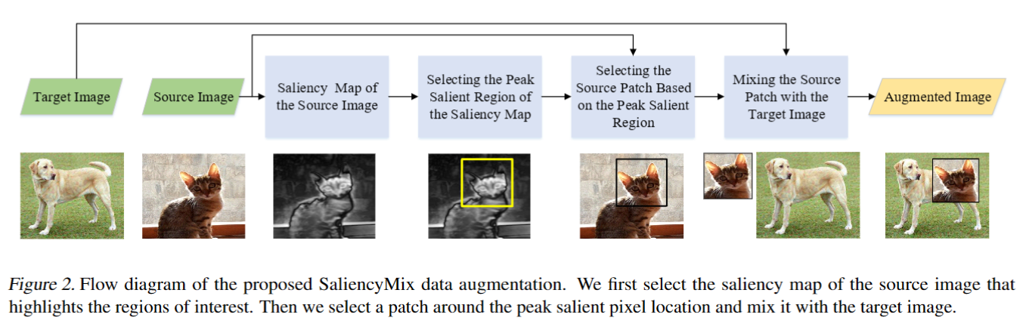
SaliencyMix: A Saliency Guided Data Augmentation Strategy for Better Regularization [ICML2020]

Slide 12
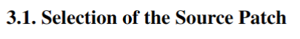
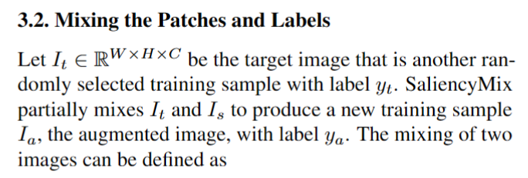
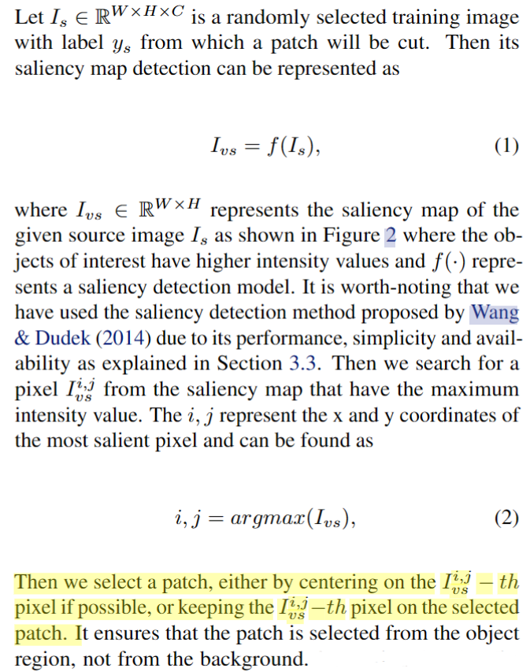
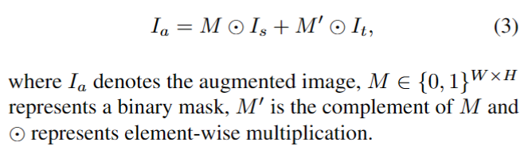
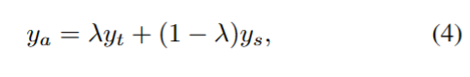
SaliencyMix: A Saliency Guided Data Augmentation Strategy for Better Regularization [ICML2020]

Slide 13
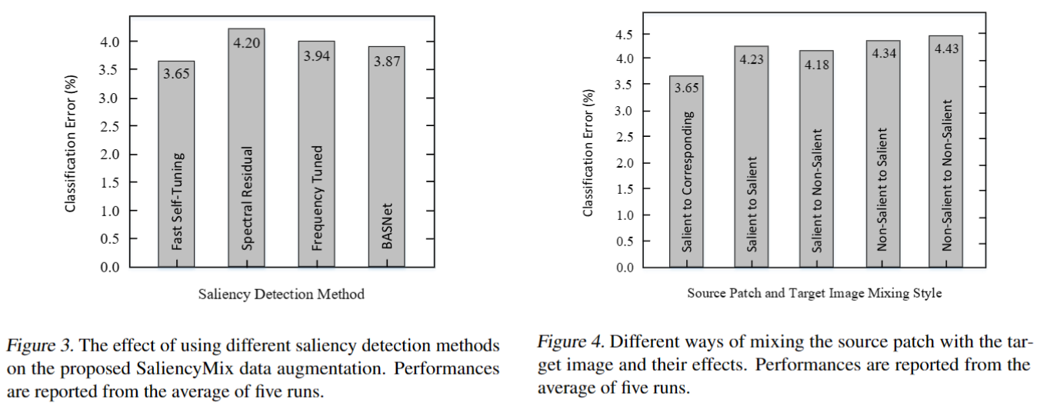
SaliencyMix: A Saliency Guided Data Augmentation Strategy for Better Regularization [ICML2020]

Slide 14
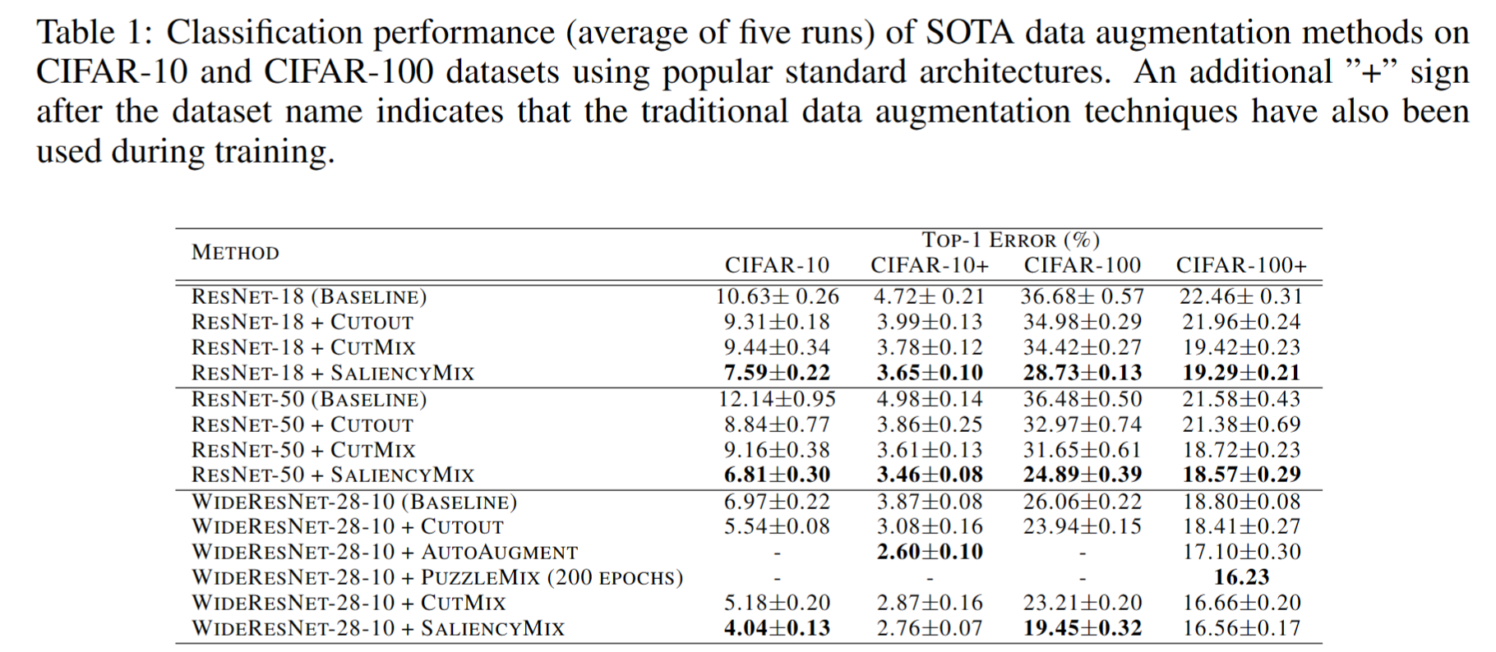
SaliencyMix: A Saliency Guided Data Augmentation Strategy for Better Regularization [ICML2020]

Slide 15
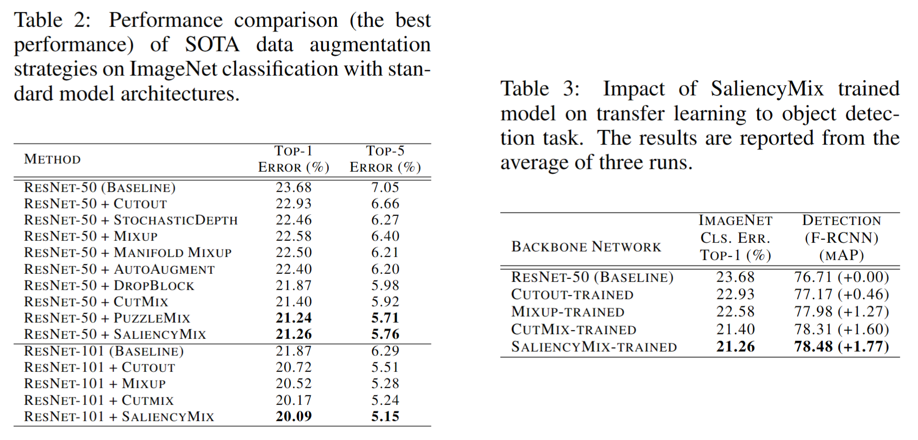
SaliencyMix: A Saliency Guided Data Augmentation Strategy for Better Regularization [ICML2020]

Slide 16
Thanks

